Slide 1
Queue
Parinya Sanguansat

Slide 2


Queue
FIFO: First-In First-Out
D
C
A
B
A

Slide 3
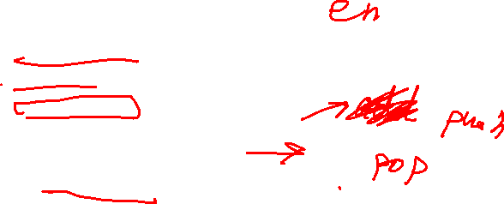
Queue Interface
public interface Queue
{
bool isEmpty();
int size();
void enqueue(object e);
object dequeue();
object peek();
}

Slide 4

Queue Services
Enqueue: put an element at the last in queue
Dequeue: remove an element at the first in queue
Peek: tell what is an element at the first in queue
queue.enqueue("A");
object x1 = queue.peek();
queue.enqueue("B");
object x2 = queue.peek();
queue.enqueue("A");
object x3 = queue.peek();
queue.enqueue("C");
object x4 = queue.peek();
queue.dequeue();
object x5 = queue.peek();
queue.enqueue("D");
object x6 = queue.peek();
D
C
A
B
A

Slide 5


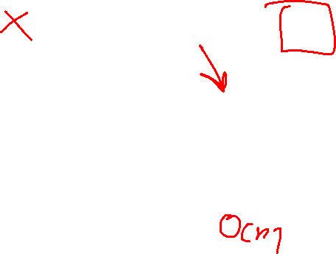
Implement with Array
Normal buffer
Fixed buffer
Wasted slots
$$Θ\left(1\right)$$
0 | 1 | 2 | 3 | 4
D
C
A
B
A
A
B
A
C
D
$$Θ(n)$$
0 | 1 | 2 | 3 | 4
D
C
A
B
A
A
B
A
C
D

Slide 6

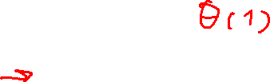
Implement with Array
Circular buffer
firstindex
$$Θ(1)$$
0 | 1 | 2 | 3 | 4
D
C
A
B
A
A
B
C
D
A

Slide 7
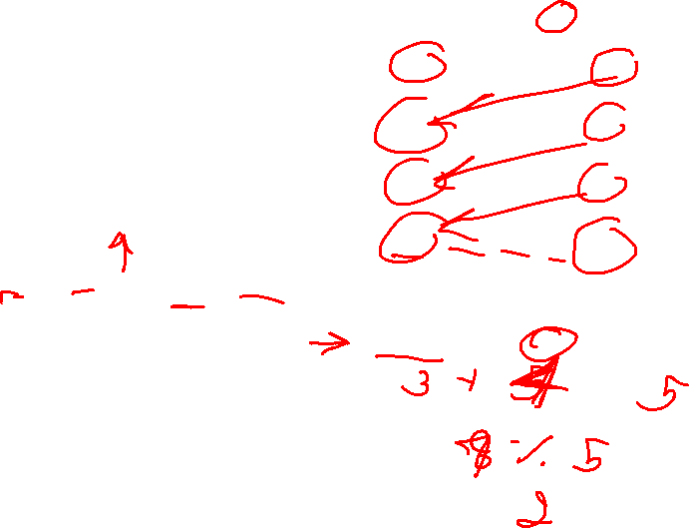
Circular buffer
Circular index
F
L
L+1
0 | 1 | 2 | 3 | 4
firstindex
1 | 2 | 3 | 4 | 0
0 | 1 | 2 | 3 | 4
2 | 3 | 4 | 0 | 1
3 | 4 | 0 | 1 | 2
A
B
C
D
D
A
C
A
D
B
B
A
C
D
C
B
firstindex
(firstindex + SIZE) % data.Length;

Slide 8
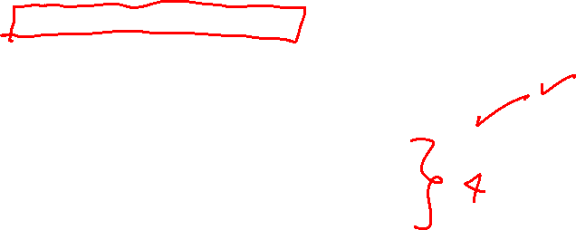
Implement with Array
ArrayQueue
public class ArrayQueue : Queue
{
private object[] data;
private int SIZE;
private int cap;
private int firstindex;
public ArrayQueue(int cap) {}
public bool isEmpty() { return SIZE == 0; }
public int size() { return SIZE; }
public void enqueue(object e) {}
public object dequeue() {}
public object peek() {}
private void ensureCapacity() {}
}

Slide 9

ArrayQueue: enqueue 1
public void enqueue(object e)
Normal buffer
EnsureCapacity
public void enqueue(object e)
{
ensureCapacity();
data[firstindex + SIZE++] = e;
}
private void ensureCapacity()
{
object[] tempdata;
if (SIZE + 1 > data.Length)
//Increase Capacity
tempdata = new object[2 * data.Length];
else if (data.Length > cap && data.Length > 2 * SIZE)
//Decrease Capacity
tempdata = new object[data.Length / 2 + 1];
else return;
for (int i = 0; i < SIZE; i++)
tempdata[i] = data[i];
firstindex = 0;
data = tempdata;
}

Slide 10
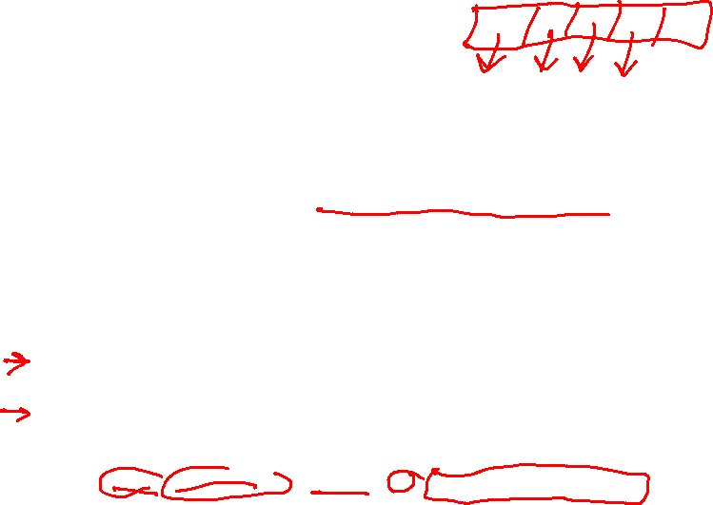
ArrayQueue: enqueue 2
public void enqueue(object e)
Circular buffer
EnsureCapacity
public void enqueue(object e)
{
ensureCapacity();
int k = (firstindex + SIZE) % data.Length;
data[k] = e;
SIZE++;
}
private void ensureCapacity()
{
object[] tempdata;
if (SIZE + 1 > data.Length)
//Increase Capacity
tempdata = new object[2 * data.Length];
else if (data.Length > cap && data.Length > 2 * SIZE)
//Decrease Capacity
tempdata = new object[data.Length / 2 + 1];
else return;
for (int i = 0, j = firstindex; i < SIZE; i++, j = (j + 1) % data.Length)
tempdata[i] = data[j];
firstindex = 0;
data = tempdata;
}

Slide 11
ArrayQueue: peek
public object peek()
D
C
A
B
A
public object peek()
{
if (isEmpty())
throw new System.MissingMemberException();
return data[firstindex];
}

Slide 12
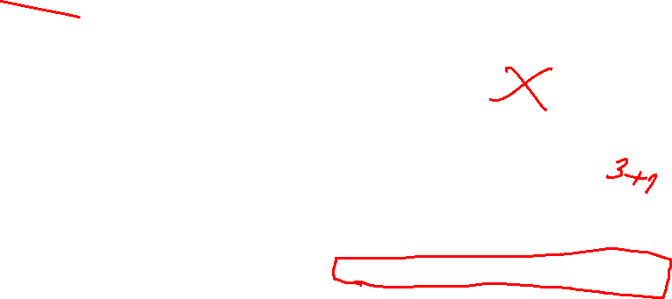
ArrayQueue: dequeue
public object dequeue()
Normal buffer
Circular buffer
public object dequeue()
{
object e = peek();
data[firstindex++] = null;
SIZE--;
return e;
}
public object dequeue()
{
object e = peek();
data[firstindex] = null;
firstindex = (firstindex + 1) % data.Length;
SIZE--;
return e;
}

Slide 13
Implement with List
Extend from ArrayList and LinkedList
 | List | Queue
Order | Y | Y
Duplicate | Y | Y
Add | Any place | Last
Remove | Any place | First

Slide 14
Implement with ArrayList
ArrayListQueue
public class ArrayListQueue : Queue
{
private List list;
public ArrayListQueue(int cap)
{ list = new ArrayList(cap); }
public bool isEmpty() { return list.isEmpty(); }
public int size() { return list.size(); }
public void enqueue(object e) {}
public object dequeue() {}
public object peek() {}
}

Slide 15
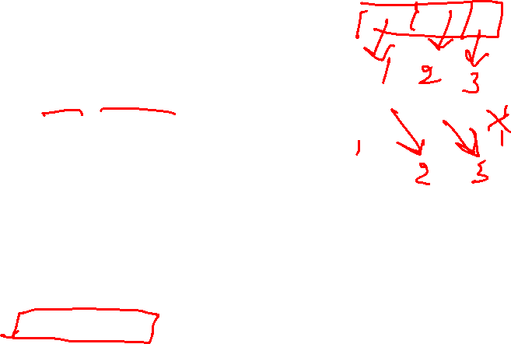
ArrayListQueue: enqueue and peek
public void enqueue(object e)
public object peek()
public void enqueue(object e)
{
list.add(e);
}
public object peek()
{
if (isEmpty())
throw new System.MissingMemberException();
return list.get(0);
}

Slide 16

ArrayListQueue: dequeue
public object dequeue()
public object dequeue()
{
object e = peek();
list.remove(0);
return e;
}

Slide 17

Implement with LinkedList
LinkedListQueue
public class LinkedListQueue : Queue
{
private List list = new LinkedList();
public bool isEmpty() { return list.isEmpty(); }
public int size() { return list.size(); }
public void enqueue(object e) {}
public object dequeue() {}
public object peek() {}
}

Slide 18
LinkedListQueue: enqueue and peek
public void enqueue(object e)
public object peek()
public void enqueue(object e)
{
list.add(e);
}
public object peek()
{
if (isEmpty())
throw new System.MissingMemberException();
return list.get(0);
}

Slide 19
LinkedListQueue: dequeue
public object dequeue()
public object dequeue()
{
object e = peek();
list.remove(0);
return e;
}

Slide 20




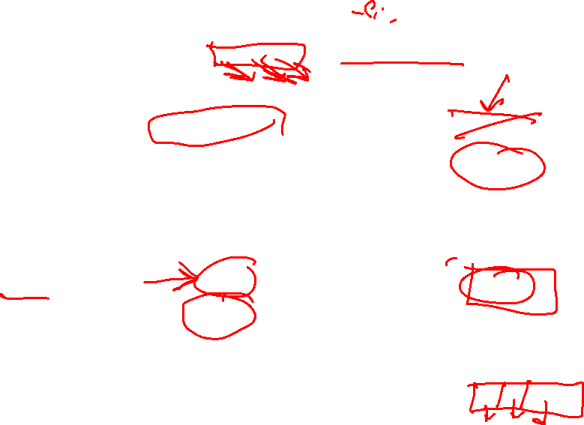














Complexity
constructor
isEmpty
size
enqueue
dequeue
peek
ArrayQueue
ArrayListQueue
LinkedListQueue
$$Θ(c)$$
$$Θ(c)$$
$$Θ(1)$$
$$Θ(1)$$
$$Θ(1)$$
$$Θ(1)$$
$$Θ(1)$$
$$Θ(1)$$
$$Θ(1)$$
$$O(n)$$
$$O(n)$$
$$Θ(1)$$
$$Θ(1)$$
$$O(n)$$
$$Θ(1)$$
$$Θ(1)$$
$$Θ(1)$$
$$Θ(1)$$

Slide 21
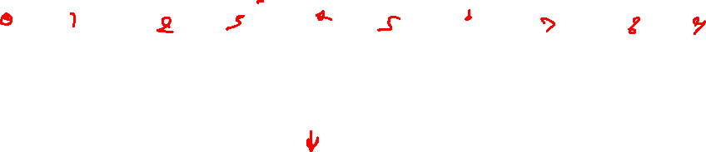
Class work 1: Radix sort
Sorting by queue
10
123
143
183
14
55
183
143
10
123
14
55
183
143
10
123
14
55
14
10
123
143
55
183

